Slide 1





Movie ticket Booking System
DMDD Group 1

Slide 2



Deepti Sankaranarayanan
Isha aJay KArankale
Meet
the
Team
Naimisha Kaza
Syeda afra
Jiewi Yang

Slide 3

Purpose
The purpose of MTRS is simulating a fully functional movie ticket booking system, the project serves as a demonstration of how various advanced database features can be integrated to create a secure, efficient, and scalable solution.
The system is designed to support the end-to-end lifecycle of movie reservations—covering functionalities such as user registration and authentication, movie and showtime listings, seat selection and availability tracking, discount applications, and ticket booking operations.

Slide 4

Objective
The primary objective of the Movie Ticket Reservation System (MTRS) is to design and implement a robust, secure, and scalable database solution that facilitates efficient movie ticket booking for users.
The system aims to streamline operations for both customers and administrators by automating reservation, seat availability, user management, and transaction tracking.

Slide 5





Scope
User management: registration, profile handling, and authentication.
Movie and show listings: including schedules, ratings, and seat information.
Booking system: allowing users to view shows, reserve tickets, and apply discounts.
Administrative features: data auditing, booking history tracking, and performance optimization.

Slide 6
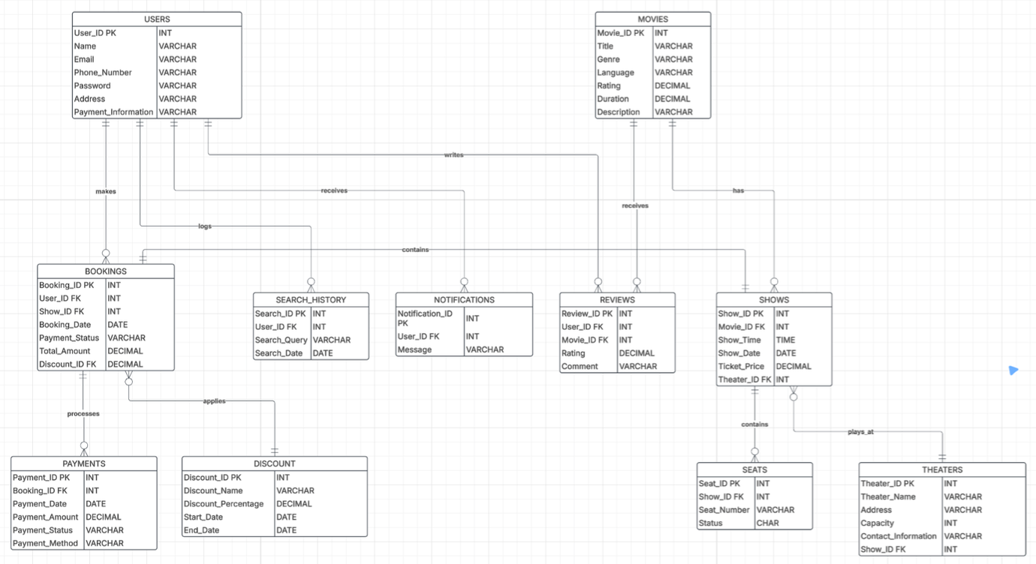
Enitity relationship diagram

Slide 7

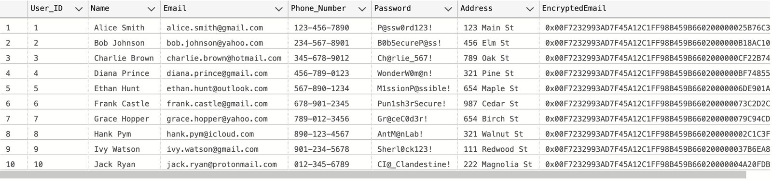
Tables - DDL
Users Table
CREATE TABLE Users (
User_ID INT PRIMARY KEY,
Name VARCHAR(255) NOT NULL,
Email VARCHAR(255) UNIQUE NOT NULL,
Phone_Number VARCHAR(20),
Password VARCHAR(255) NOT NULL,
Address VARCHAR(255)
);
SELECT * FROM Users;

Slide 8
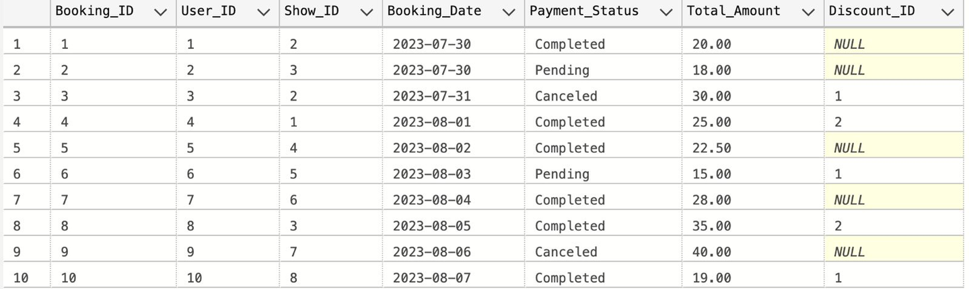
Tables - DDL
Bookings Table
CREATE TABLE Bookings (
Booking_ID INT PRIMARY KEY,
User_ID INT,
Show_ID INT,
Booking_Date DATE NOT NULL,
Payment_Status VARCHAR(20) CHECK (Payment_Status IN ('Pending', 'Completed', 'Canceled')),
Total_Amount DECIMAL(10, 2),
Discount_ID INT,
FOREIGN KEY (User_ID) REFERENCES Users(User_ID),
FOREIGN KEY (Show_ID) REFERENCES Shows(Show_ID),
FOREIGN KEY (Discount_ID) REFERENCES Discounts(Discount_ID)
);
SELECT * FROM Bookings;

Slide 9

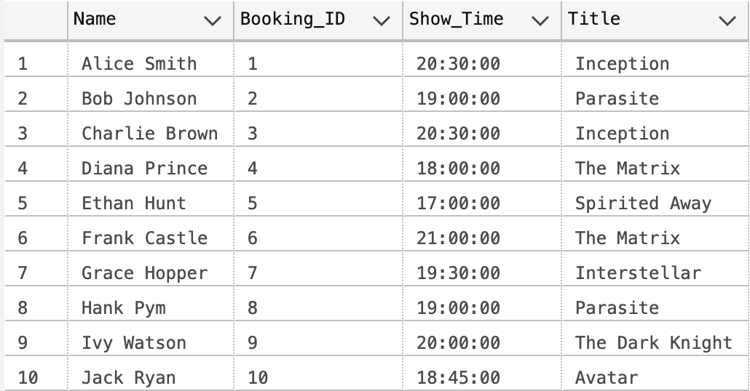
Views
UserBookingDetails View
Purpose:
Joins Users, Bookings, Shows, and Movies to display detailed booking information, including the user’s name, booking ID, movie title, and showtime.
Key Columns:
UserName (Customer’s name)
BookingID (Booking ID)
ShowTime (Time of the movie show)
MovieTitle (Title of the movie)
Optimizes Data Retrieval:
Simplifies fetching all user booking details, reducing complexity in reporting and analysis.

Slide 10
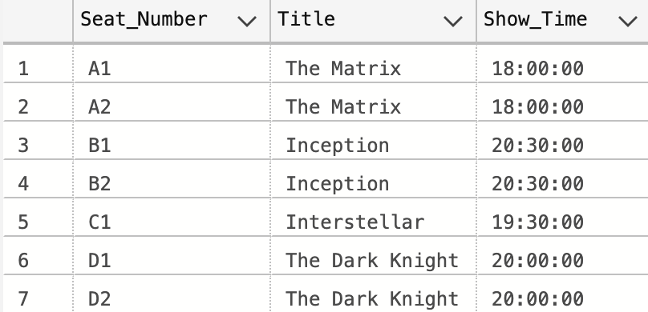
Views
AvailableSeats View
Purpose:
Displays available seats for each movie show by joining Seats, Shows, and Movies, filtering for seats that are available.
Key Columns:
SeatNumber (The seat number in the theater)
MovieTitle (Title of the movie)
ShowTime (Time of the movie show)
Optimizes Data Retrieval:
Provides a quick overview of available seating for each movie show, making seat booking easier.

Slide 11
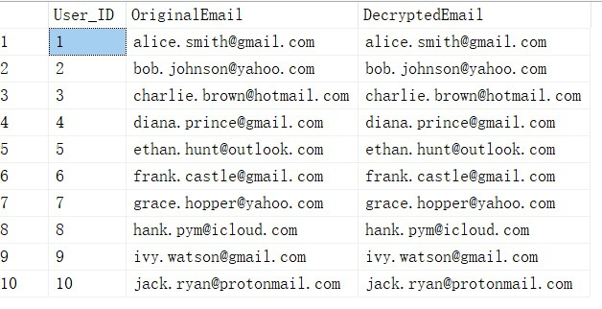
Encryption
A Database Master Key was created using a password and stored securely in the master database to protect the encryption hierarchy
The OriginalEmail column from the user table was converted to VARBINARY(MAX) and encrypted using the ENCRYPTBYKEY() function while the symmetric key was open.
Encrypted email values were stored in a new column (e.g., EncryptedEmail), maintaining data confidentiality at rest.
To retrieve the data, the symmetric key was opened using the same certificate, and the binary data was decrypted using DECRYPTBYKEY().

Slide 12
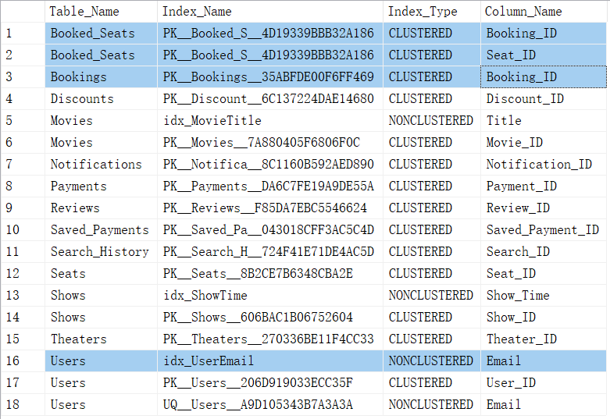
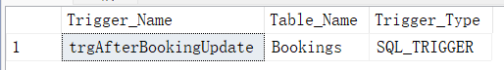
Indexes, Udfs, triggers & stored procedures
Index Name: PK_Booked_S
Index Type: CLUSTERED
Description: This index is the primary key for the Booked_Seats table and stores data in order by seat bookings.
Index Name: PK_Bookings
Index Type: CLUSTERED
Description: This index is the primary key for the Bookings table and helps quickly find booking records.
Index Name: idx_UserEmail
Index Type: NONCLUSTERED
Description: This index speeds up searches using the Email column in the Users table.
Trigger：This trigger activates after an update to the Bookings table, logging changes for audit purposes.
Indexes
TRIGGERS

Slide 13
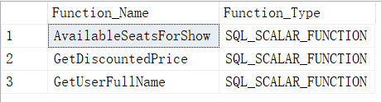
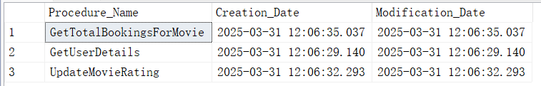
Indexes, Udfs, triggers & stored procedures
Function Name: AvailableSeatsForShow
Description: This function returns the number of available seats for a movie show.
Function Name: GetDiscountedPrice
Description: This function calculates the discounted price based on the original price and discount rate.
Function Name: GetUserFullName
Description: This function gets the full name of a user using their unique ID.
Stored Procedures：
GetTotalBookingsForMovie: Calculates and returns the total number of bookings for a specific movie.
GetUserDetails: Retrieves detailed information about a user based on their unique ID.
UpdateMovieRating: Updates the rating of a specific movie.
UDFs
STORED PROCEDURES

Slide 14
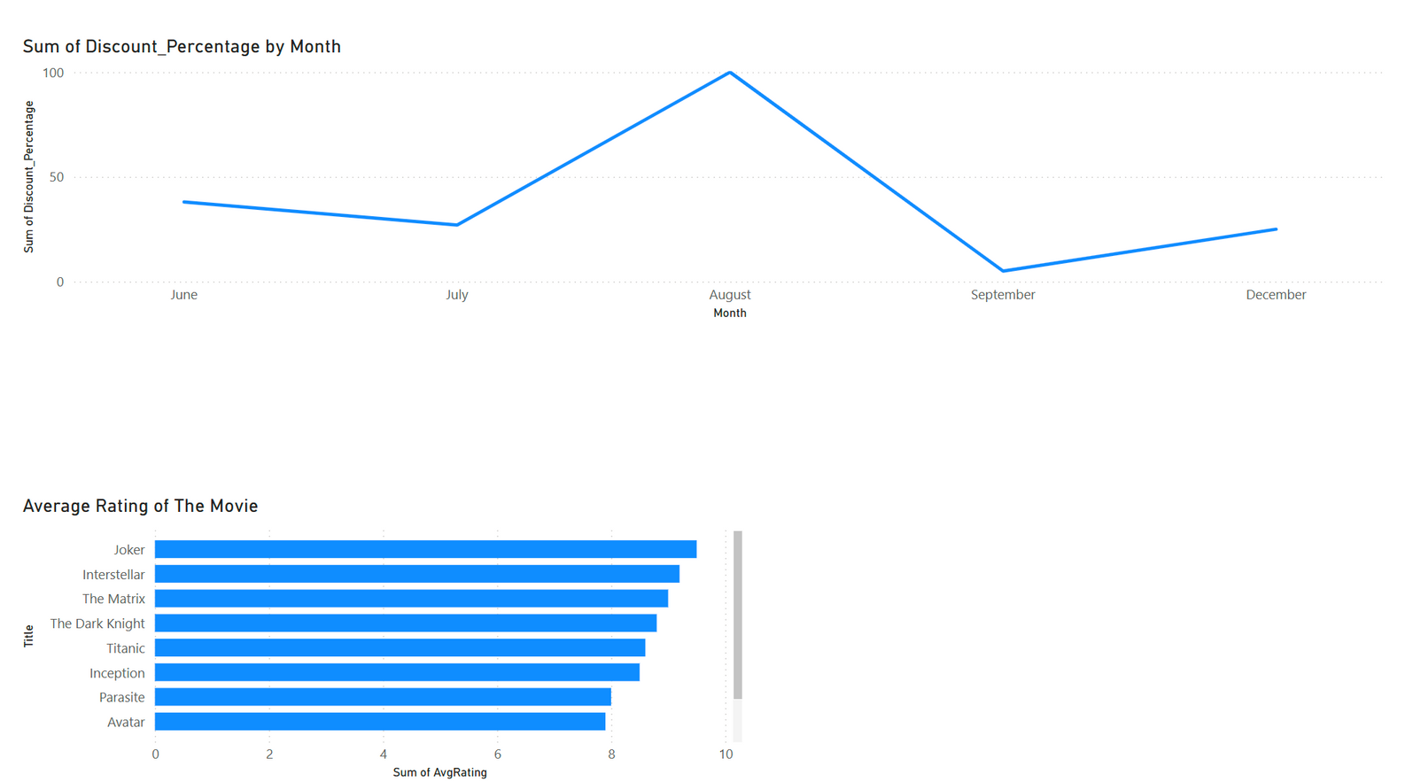
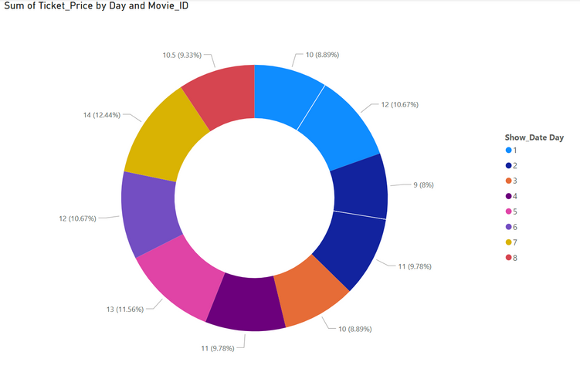
PowerBI Dashboard

Slide 15

Conclusion
Elevating the Movie Reservation Experience
1
2
3
4
Data Integrity
MTRS ensures consistent and reliable data using stored procedures, triggers, and transactions.
Security
Sensitive information, such as encrypted user credentials and payments, protects privacy and builds trust.
Efficiency
MTRS streamlines movie booking with fast queries and smooth user transactions.
Insights-Driven
MTRS uses Power BI to turn booking data into insights for smarter decisions.

Slide 16

Live demo
time
Grab the popcorn!

Slide 17

Thank
you

